Slide 1


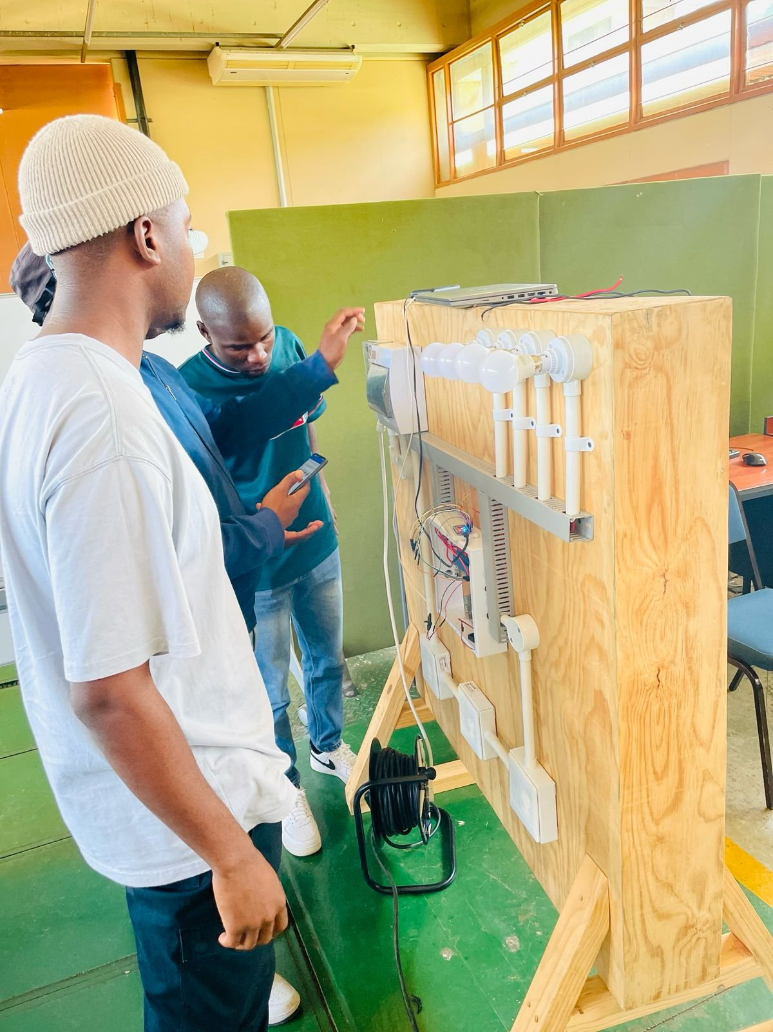
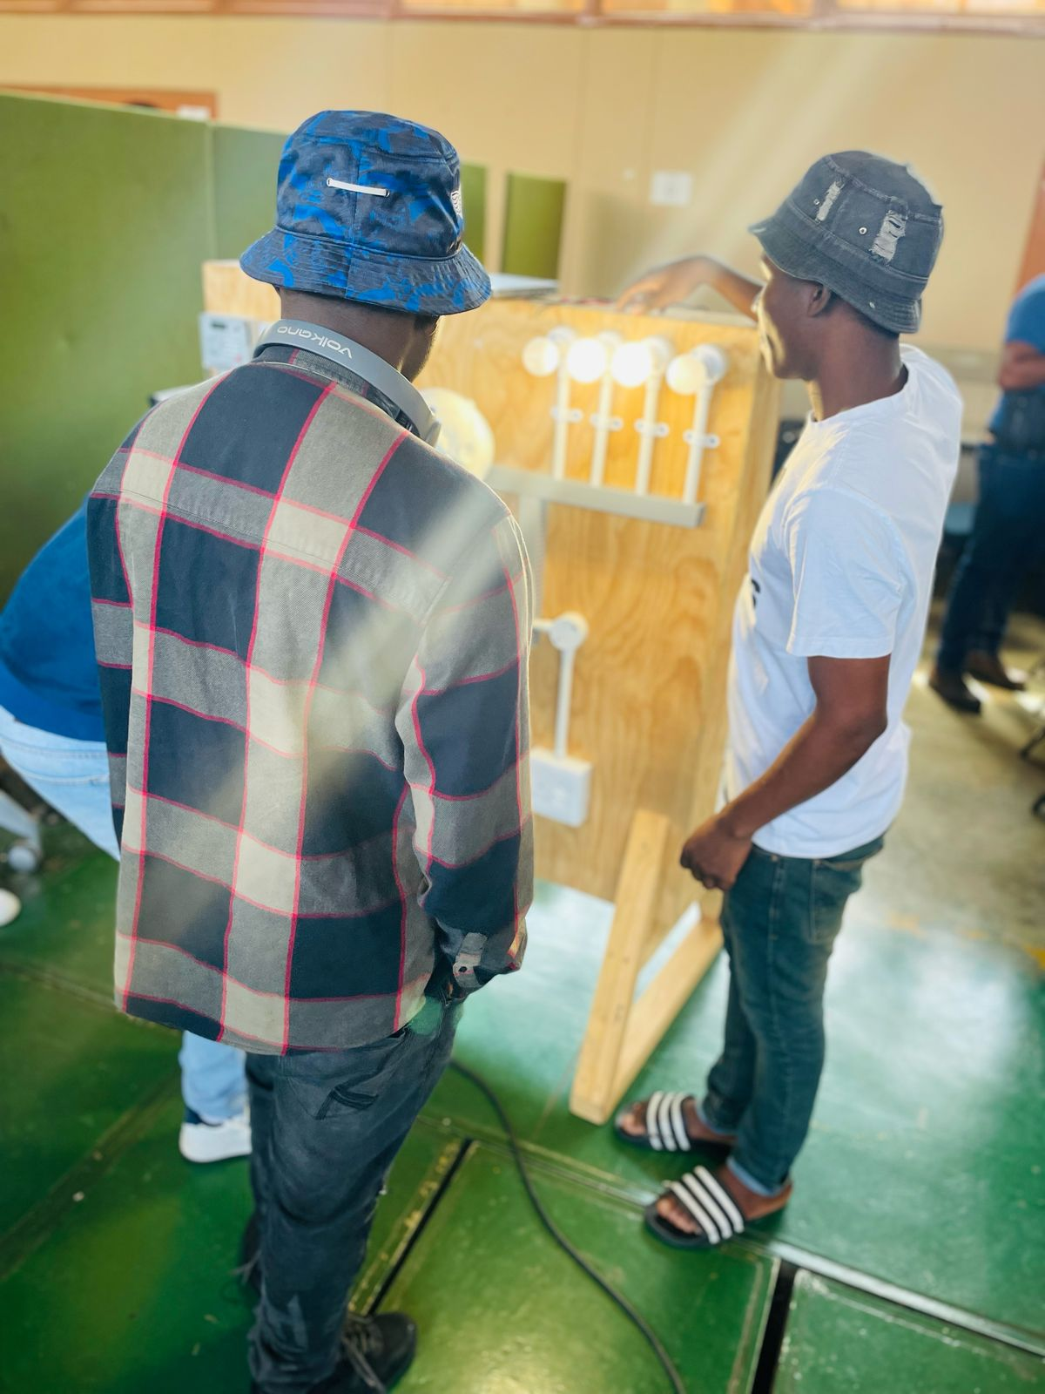
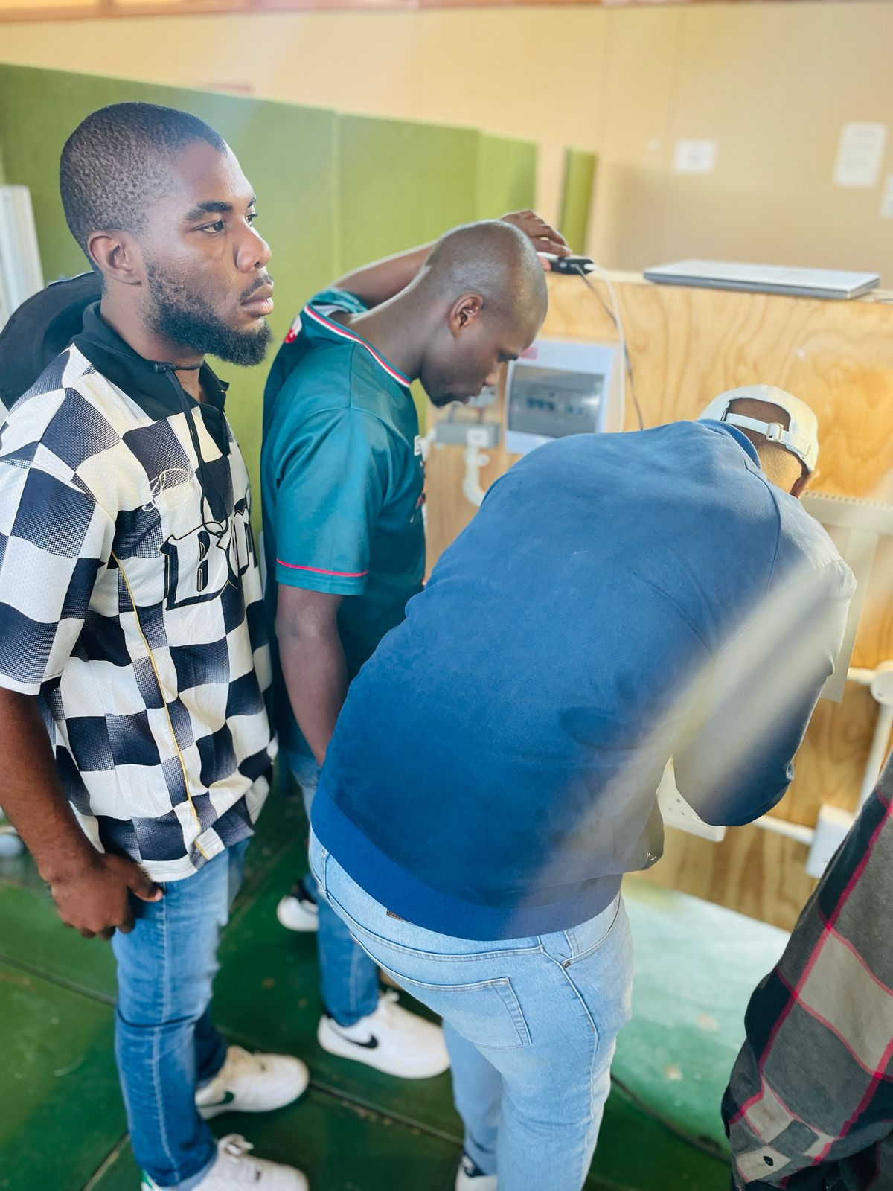
SMART HOUSE PRESENTATION
PD1315D – Group 6A
LECTURERS: DT MATSHIBA & SN MNGOMEZULU
Group members: MASHELE cm, SHAKUDYIWA n, Shibiti nc, makwakwa d, Maluleke vr, nhlebela s
Department of computer systems engineering

Slide 2
contents
Introduction
System Overview
Application & Microcontroller Used
Block & Circuit Diagram
Code Snippet
Future Improvements
Challenges Faced
Conclusion

Slide 3
introduction
This report documents the design and development of a Bluetooth-controlled smart home automation system. The aim of the system is to enable wireless control of common household appliances such as lights and all indoor appliances through Bluetooth communication. The project uses an ESP32 microcontroller for its integrated Bluetooth capabilities, allowing for compact, efficient, and reliable operation. This smart system enhances convenience, energy efficiency, and safety in residential environments.

Slide 4
System OvervIEW
The system allows users to wirelessly control various home appliances such as lights, a fridge, AC, stove, and a TV using a Bluetooth connection. We used an ESP32 microcontroller because of its built-in Bluetooth, making it compact and efficient. Commands are sent from a mobile device to the ESP32 in the form of simple numbers. The microcontroller decodes each command to determine which device to control and whether to turn it ON or OFF.
Each device is connected through a GPIO pin and activated using digital signals. When a device is turned ON, a timer starts, and if no further action is taken, the system automatically turns the device OFF after 30 seconds to save power and prevent hazards.

Slide 5
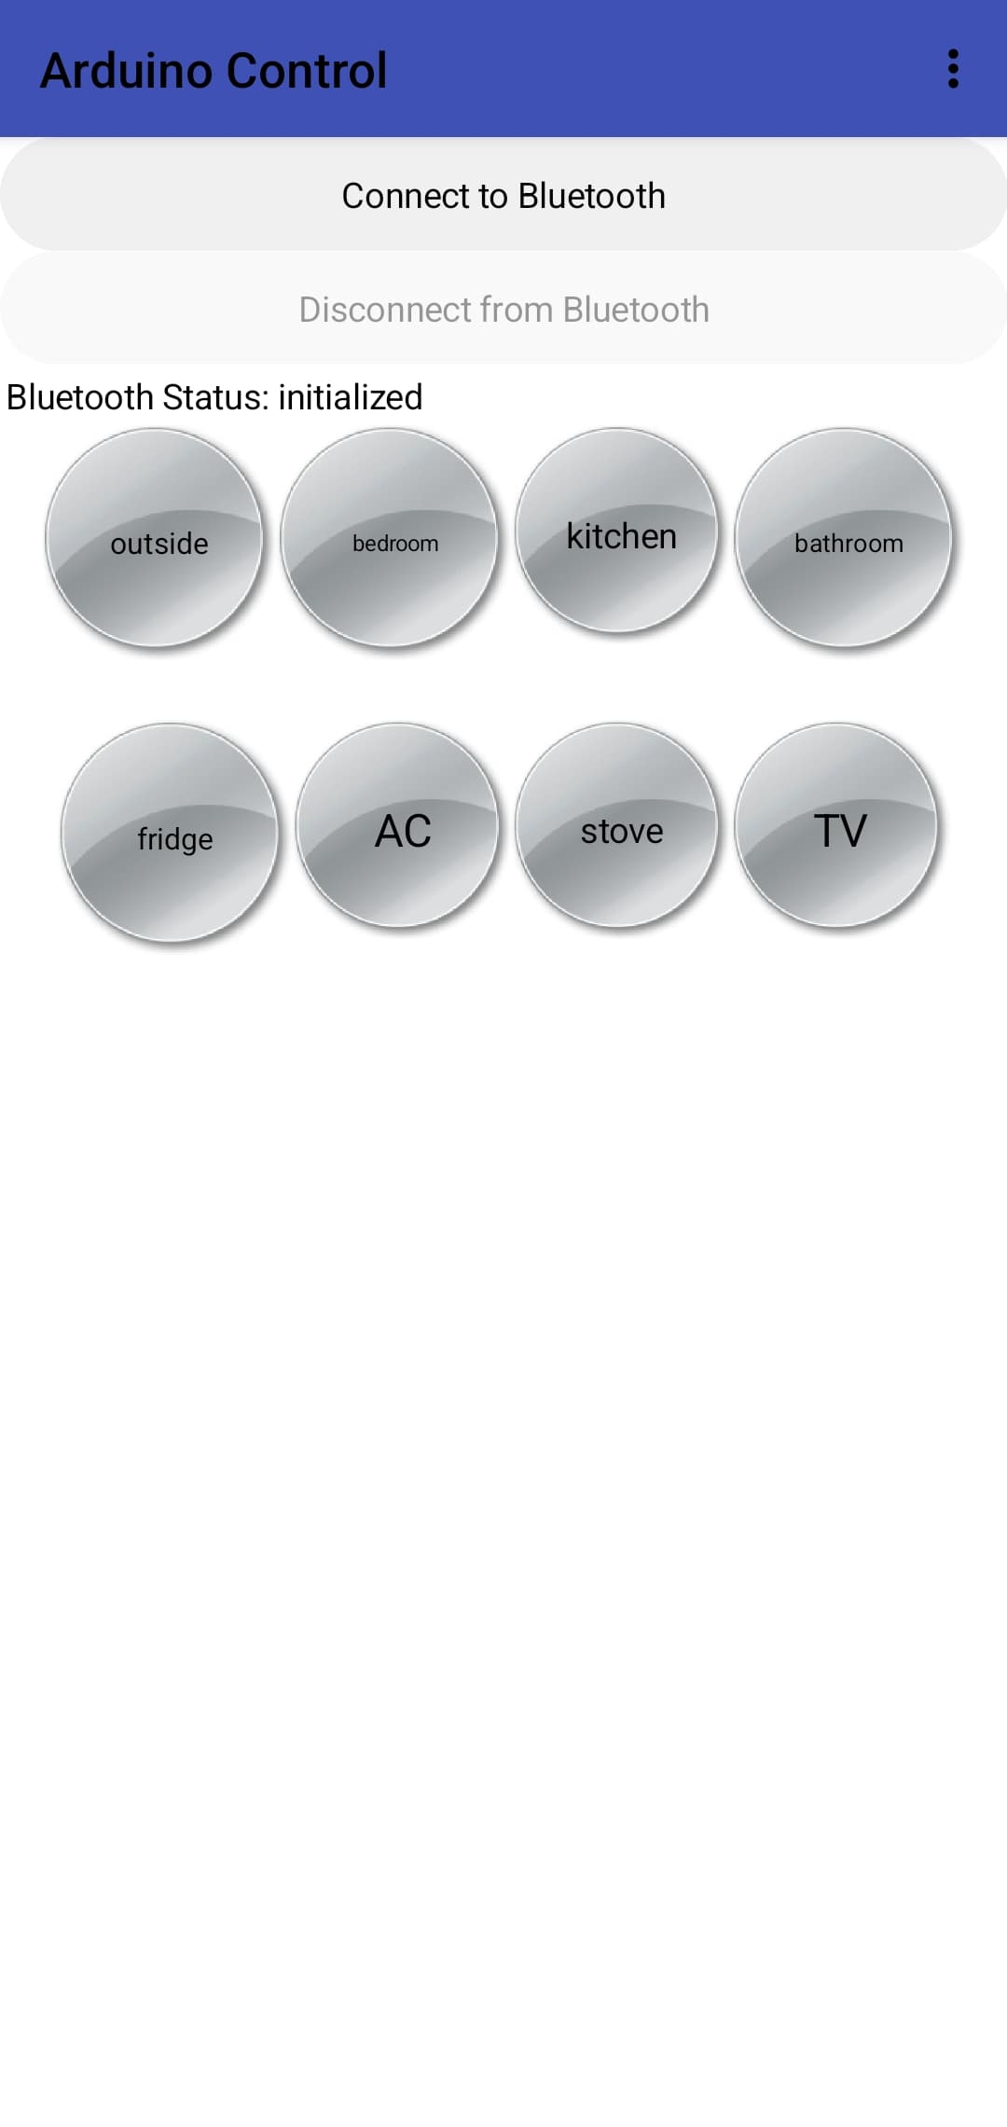
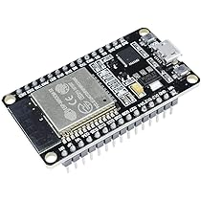
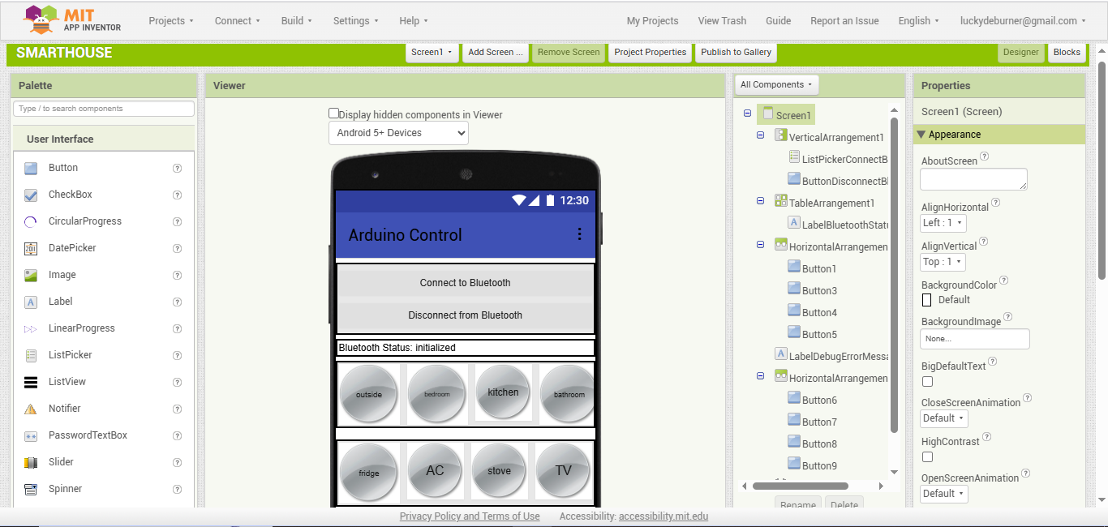
Application & microcontroller used
Application: MIT App Inventor (AI2 Companion)
The smart home is controlled using mobile app developed with MIT App inventor. The AI2 companion allows real-time testing and interaction with the app on Android and IOS devices. The Bluetooth terminal app is used to send control signals to the ESP32.
A two-digit number is sent serially to the ESP32 to indicate the ‘button’ pressed and its ‘state’. For example, “11” is sent to turn on the outdoor light if the button is pressed, “10” to switch off.
Microcontroller: ESP32
The ESP32 is a powerful and low-cost microcontroller with built-in WI-FI and Bluetooth capabilities. It acts as the central controller of the smart home, receiving commands from mobile app and interacting with connected sensors and actuators ( such light, fans , etc..).

Slide 6
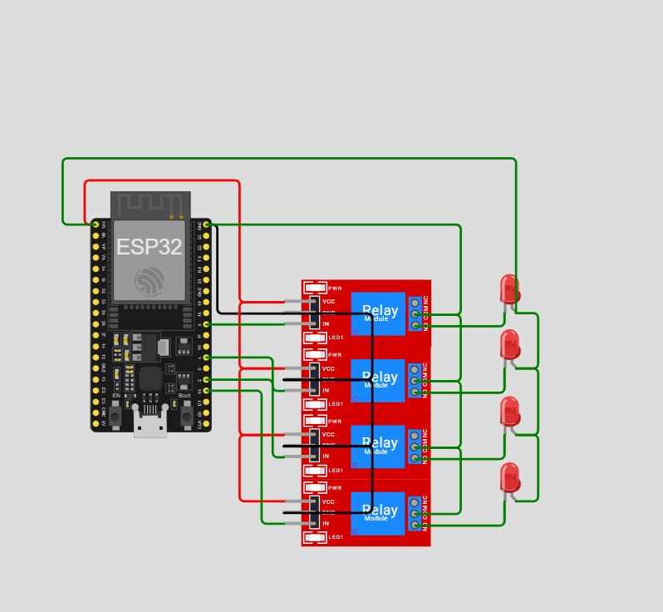
Block diagram
Each appliance is connected to a relay module, which is in turn controlled by a GPIO pin on the ESP32.
The Bluetooth module receives control commands from the mobile app.
For safety, opto-isolated relays are used to handle high voltages. The system operates at low voltage on the control side, ensuring safe interaction with the microcontroller.

Slide 7
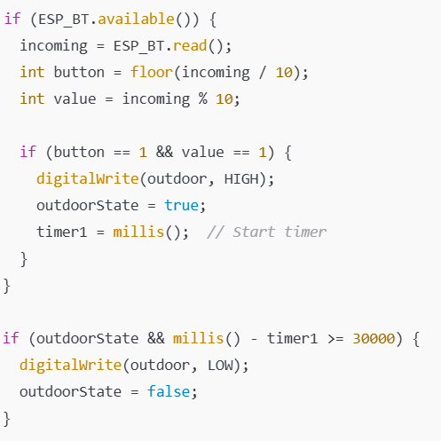
Code snippet(Bluetooth + auto-off code)
The system receives control commands via Bluetooth from a mobile application. Each command is split into two parts: the device to control and the action to perform (ON or OFF).
When a command is received, the ESP32 activates or deactivates the corresponding relay output.
For safety and energy efficiency, certain devices like lights are configured to turn off automatically after 30 seconds using the millis() function to track elapsed time.
This approach ensures simple, reliable control with added automation for better power management.

Slide 8
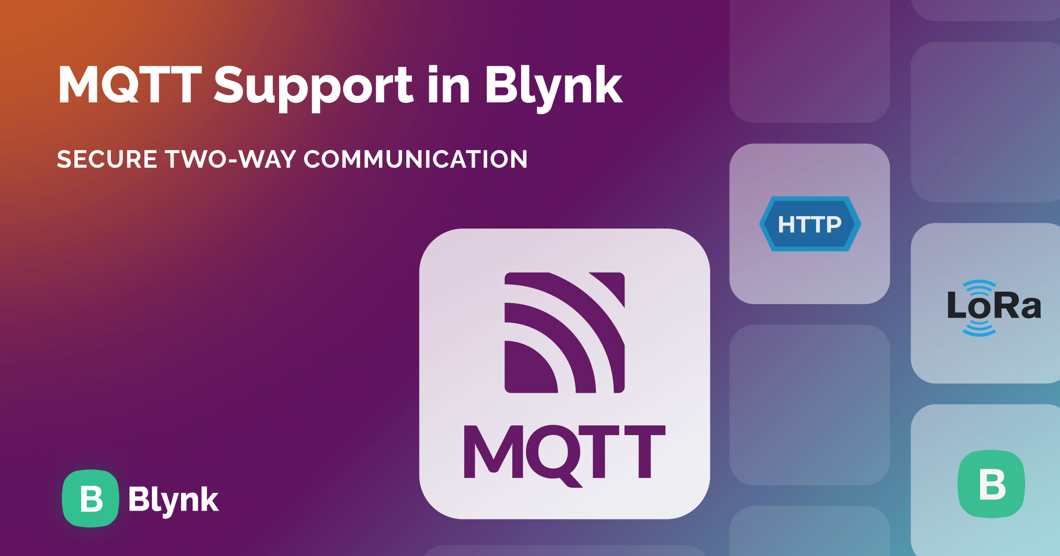
Future Improvements
In the future, the smart home system can be improved by replacing Bluetooth with Wi-Fi or IoT platforms like Blynk or MQTT, allowing users to control the system from anywhere. Voice control using Google Assistant or Alexa can be added for hands-free operation. The system can also be enhanced with sensors to automate actions based on movement

Slide 9
Challenges Faced
During the development of the smart home system, one of the main challenges was ensuring stable Bluetooth connectivity between the mobile app and the ESP32. Sometimes the connection would drop, requiring re-pairing.
Managing the power supply for both the ESP32 and the connected devices also needed attention to avoid overload or malfunction. Supplying the relay module with enough power was especially important, as insufficient current could cause the relays to malfunction or switch unpredictably.

Slide 10
conclusion
This smart home project successfully demonstrated how common household appliances can be controlled wirelessly using the ESP32 microcontroller and a mobile app developed with MIT App Inventor. The system provides a simple, cost-effective solution for improving home convenience, safety, and energy efficiency. Despite a few challenges during development, the project achieved its goals and lays the foundation for future upgrades such as Wi-Fi control, voice commands, and automation through sensors.

